Slide 1

Welcome to Summer Day Camp
Highlight Information
Louisville Recreation & Senior Center
For more detailed policies and procedures, please consult the Summer Day Camp Handbook
Notes:
Mandy- introductions

Slide 2
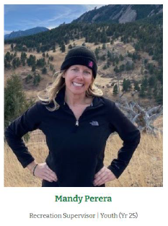
Questions & Answers
You may e-mail Mandy mandyp@louisvilleco.gov
During the summer, we recommend you speak with your Assistant Directors who are in camp each day.
Notes:
Mandy – respect your time and complexities of some questions

Slide 3

General Information
Monday through Thursday | 8:00am-4:30pm
2025-2026 School year children in grades K-5
Camp home base is the turf gym, turf lot and playground on the South side of the facility | TIP: park by the playground and enter at the large garage door
Other areas of the Recreation & Senior Center are utilized
Camp webpage www.LouisvilleRecreation.com
  FAQ
  Camp Handbook
  Highlights Calendars
Camp Cell Phone
720-614-9539
Notes:
Mandy *cell phone for camp

Slide 4

Goals for camp
Create a safe, caring, welcoming & inclusive environment
Provide positive guidance techniques and assist campers in developing their own problem solving skills and self confidence
Opportunities for new experiences and growth
Friendships & fun
Sense of belonging
Notes:
Regan

Slide 5

Illness Prevention
How you can help:
Keep campers home with any sign of illness
E-mail mandyp@louisvilleco.gov to report illness and exposure. Include:
  Circumstances / Symptoms
  Day and time symptoms began
Notes:
Mandy – stay home with any symptoms – pre-existing conditions with a note for health care provider can attend

Slide 6
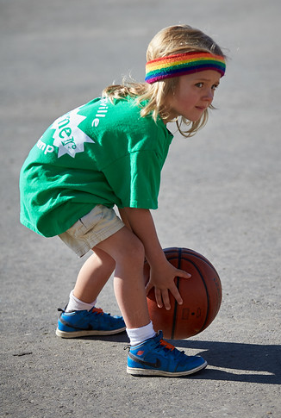
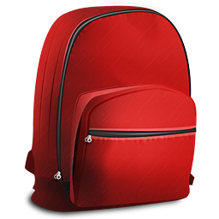
What to bring to camp
Everyday
Swim Days | Tuesday & Thursday
Lunch with icepack if needed, 2 snacks & a leak-proof water bottle
Wear play clothes and sneakers
Sun protection: covered shoulders, hat, glasses are recommended
Book to read
All items kept in a backpack that is a manageable size for your camper
Swim suit under clothes
Dry change of clothes
Towel
Goggles are optional
Swim shirts are provided for the day
Notes:
Makenna

Slide 7
What NOT to bring to camp
Open toe shoes or Crocs- they do not provide adequate support and safety for running & playing
Hand sanitizers
Individual sunscreen (unless approved by Assistant Directors)
Valuables
Toy or real weapons
Notes:
Makenna

Slide 8
What to expect at Check-In & Check-Out
Check-In | Turf Gym Garage Door at the South East side of the facility
Parents apply first coat of sunscreen before/at check-in, sunscreen will be reapplied throughout the day
Parents answer sunscreen application question on their ePACT app to expedite check-in
Doors open and & Check-in begins at 8am | please arrive by 8:45am in order for your camper to take part in the morning camp meeting
Check-in at the Welcome Table inside the Turf Gym Garage Door
8am-8:45am | Free Choice Time
If arriving late, please call the camp cell phone for check-in location
Check-Out | Turf Gym Garage Door at the South East side of the facility
Small Group activities generally wrap up at 4pm | 4pm-4:30pm Free Choice Time
Check-out at the Welcome Table in the Turf Gym
Notes:
Regan

Slide 9
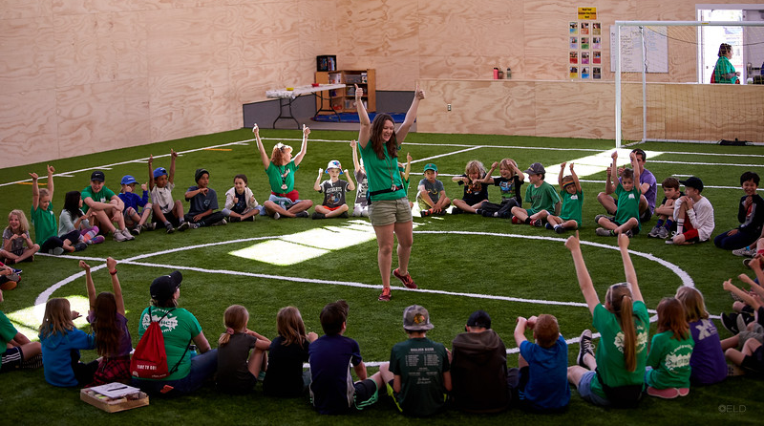
What to expect at Check-In & Check-Out
Campers with written permission to check in/out without a parent
Parents may indicate on ePACT if their camper is permitted to sign themselves in and out of camp
Per state recommendations, this is only for campers age 8+
Campers are expected to arrive by 8:45am and will not be released until 4:30pm without written permission of a change request
Once checked in, campers must stay in the care of camp staff at all times until check out.
Campers must be picked up by 4:30pm. Repeated late pick-ups will result in a meeting with the Recreation Supervisor and enrollment may be cancelled with no refund/credit.
$10 for 1-5 minutes late
$30 for 6-15 minutes late
$60 for 16-30 minutes late
Notes:
Regan

Slide 10

Typical day at camp
Friendships & Fun
Crafts
Games/Sports
Outdoor Play| Playground | Arboretum
Guest Presentations
Field Trips
Swim Days at LRC
Reading/Quiet Activities
Notes:
Regan

Slide 11
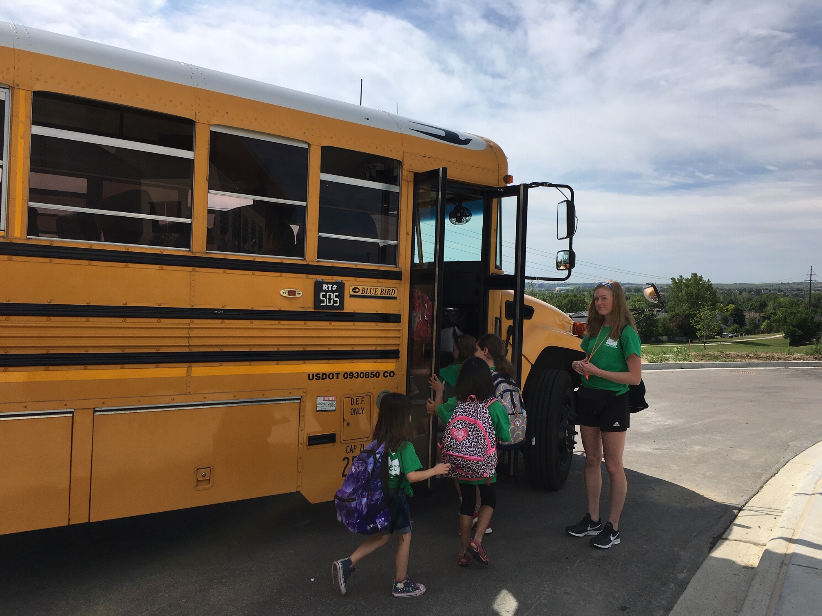
Field Trips
Wednesdays | Arrive by 8:45am to prepare for departure
Camp calendars posted online and at Camp Welcome Table include location, times and any special notes
Wear Green Summer Day Camp T-shirt | Given out 1st week attending camp
Backpack large enough to carry lunch & water bottle, and is manageable for camper to carry independently
Notes:
Makenna

Slide 12
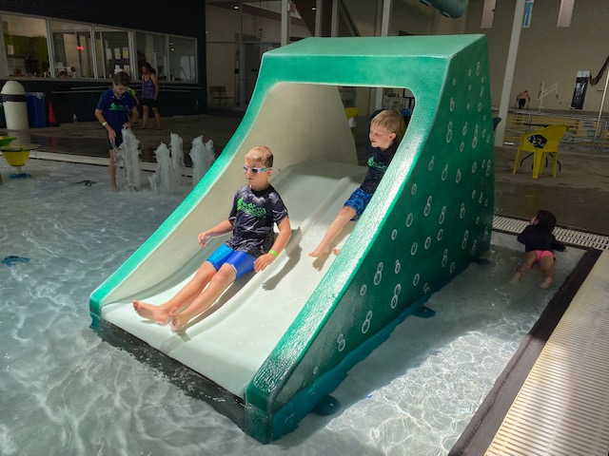
Swimming | Louisville Recreation Center
Tuesdays & Thursdays | 1:30-3:30pm
  RED SWIM BAND for campers less than 3’6” at the shoulder | permitted access to zero depth side of the splash pool
  NO SWIM BAND for campers taller than 3”6” at the shoulder | additional access to basketball hoop, lazy river in splash pool.
  GREEN SWIM BAND Campers who have passed a Summer Day Camp swim test with a LRC lifeguard |additional access to basketball hoop, lazy river & zip line side of splash pool and program pool.
Swim test is optional. There is lots to do in the zero depth pool with lots of campers and staff playing.
All campers and counselors wear a Summer Day Camp rash guard, issued for the day
Counselors actively supervise and participate in the water with campers in rotating stations
Campers arrive to camp in swim suit under clothes with a towel and change of clothes in backpack
If campers would like to shower, they must stop swimming by 3pm in order to have time, talk with a Assistant Director
Notes:
Makenna

Slide 13
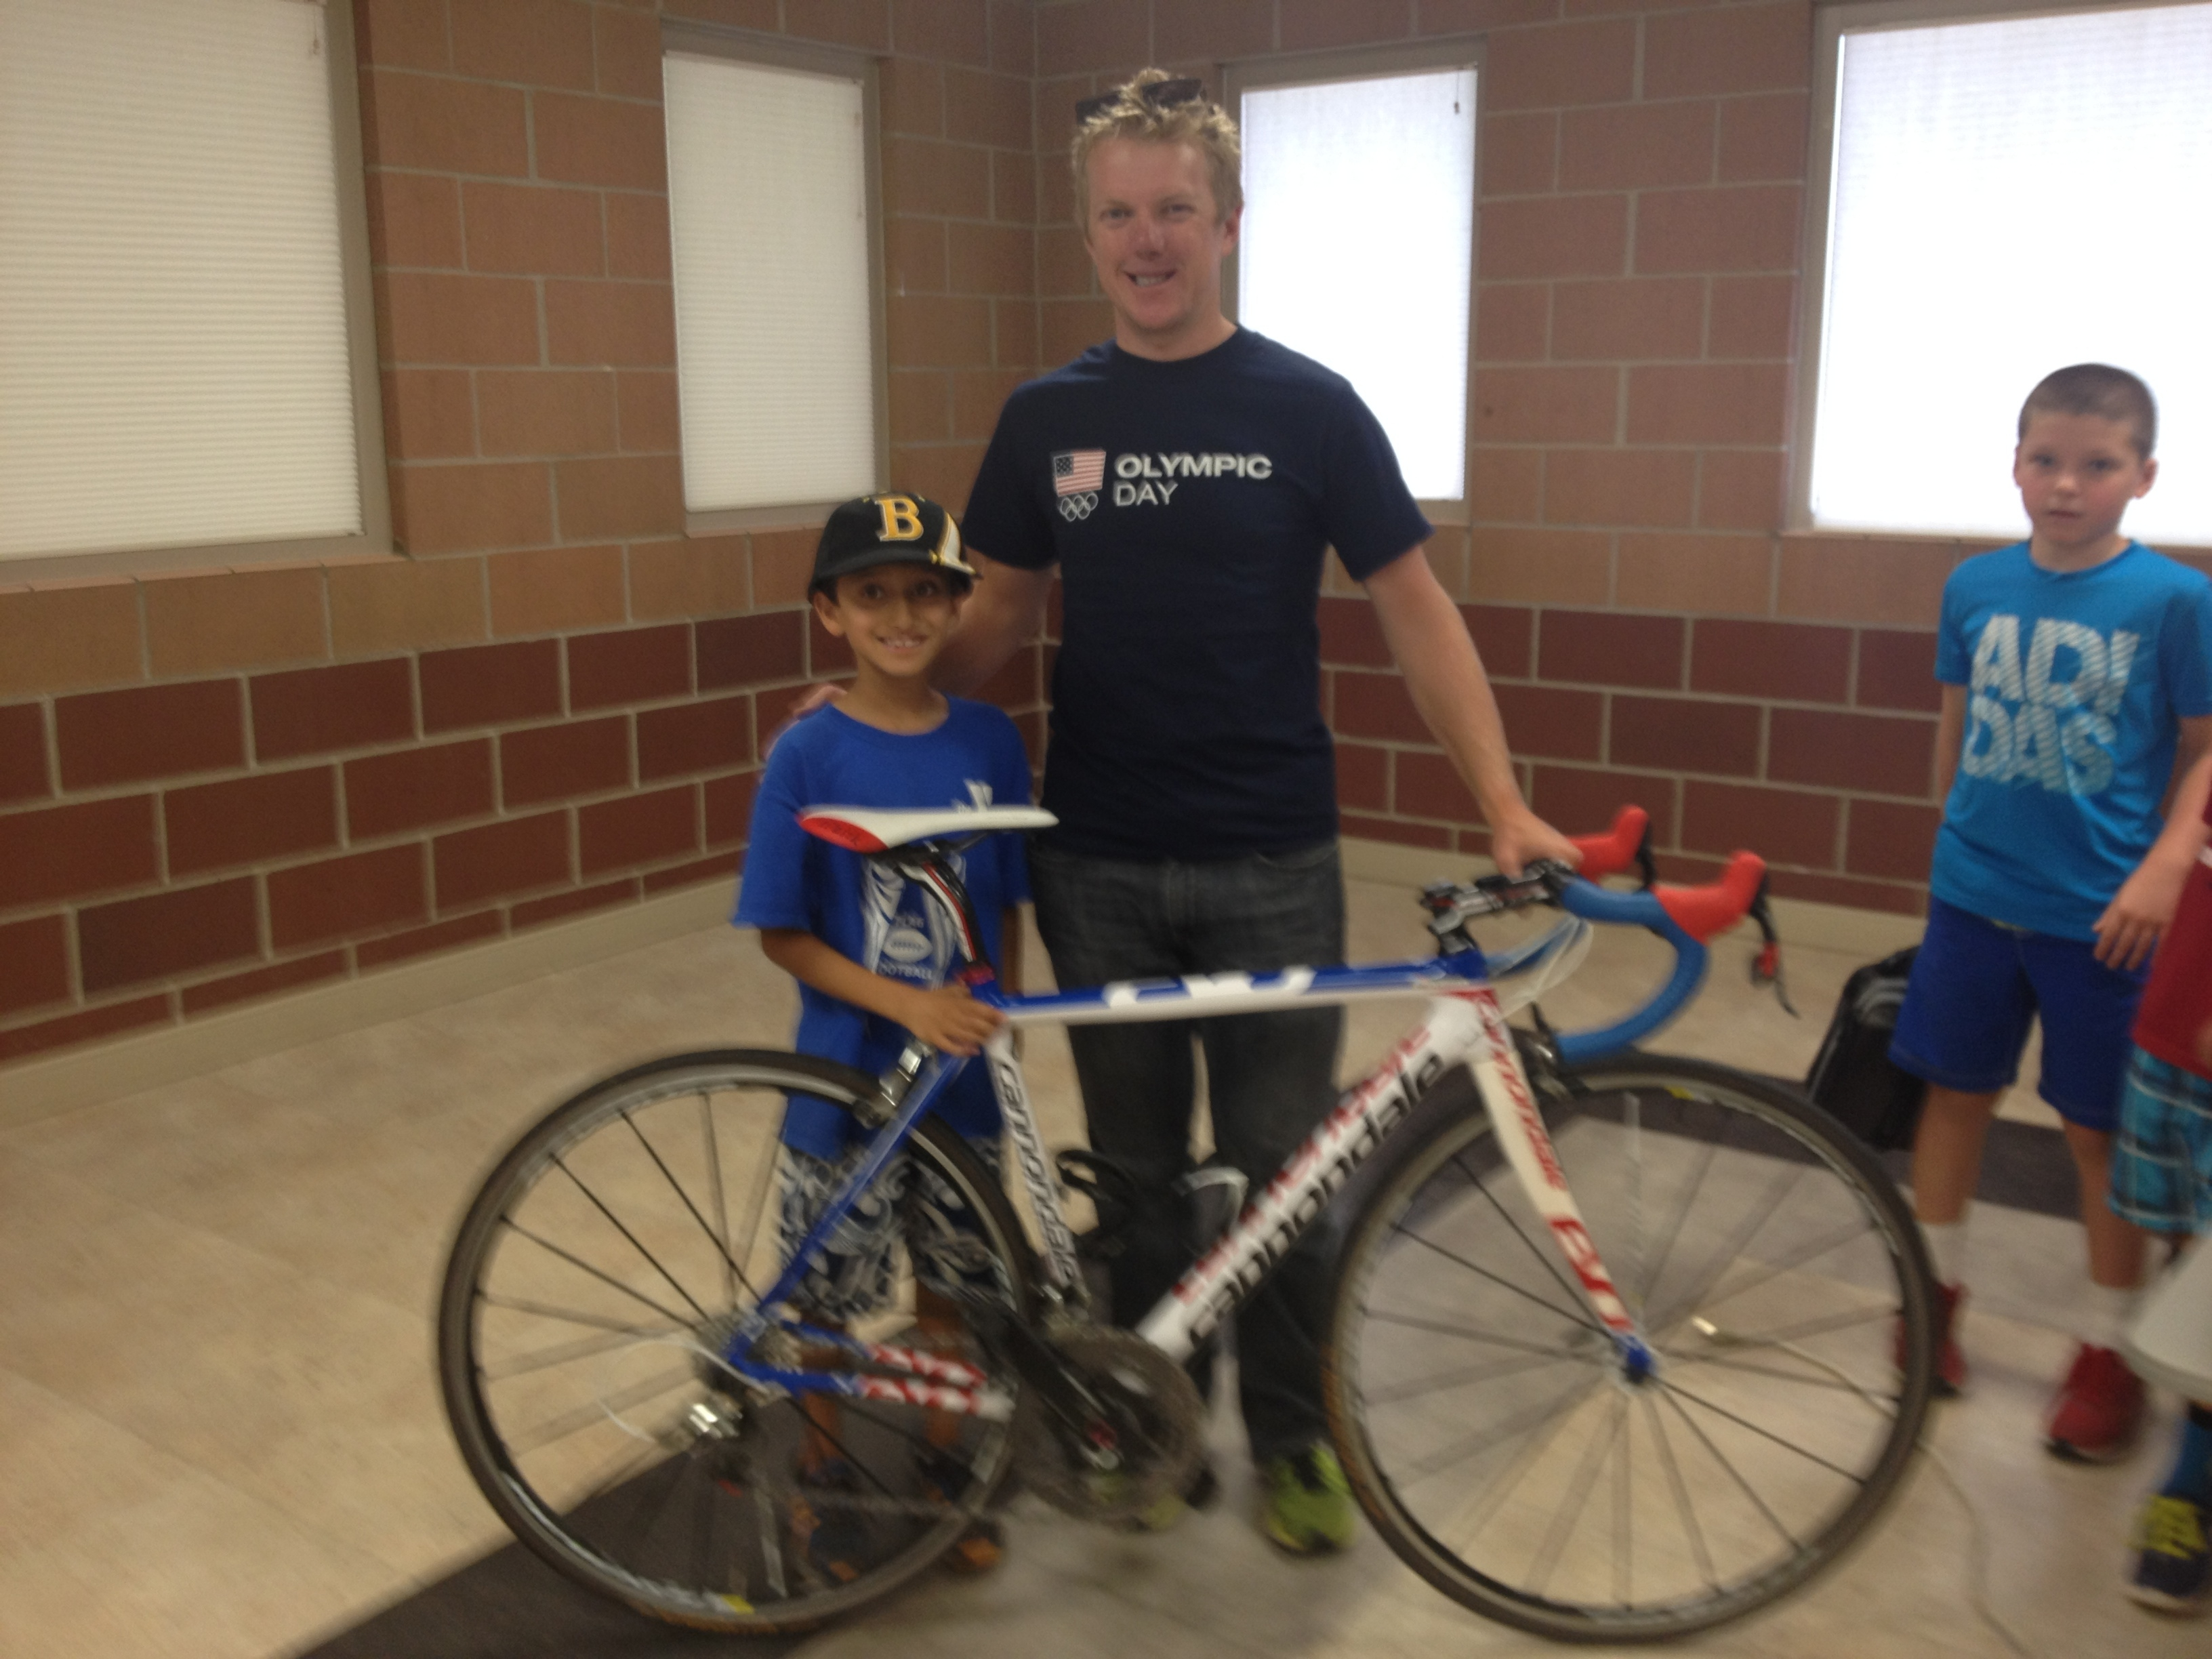
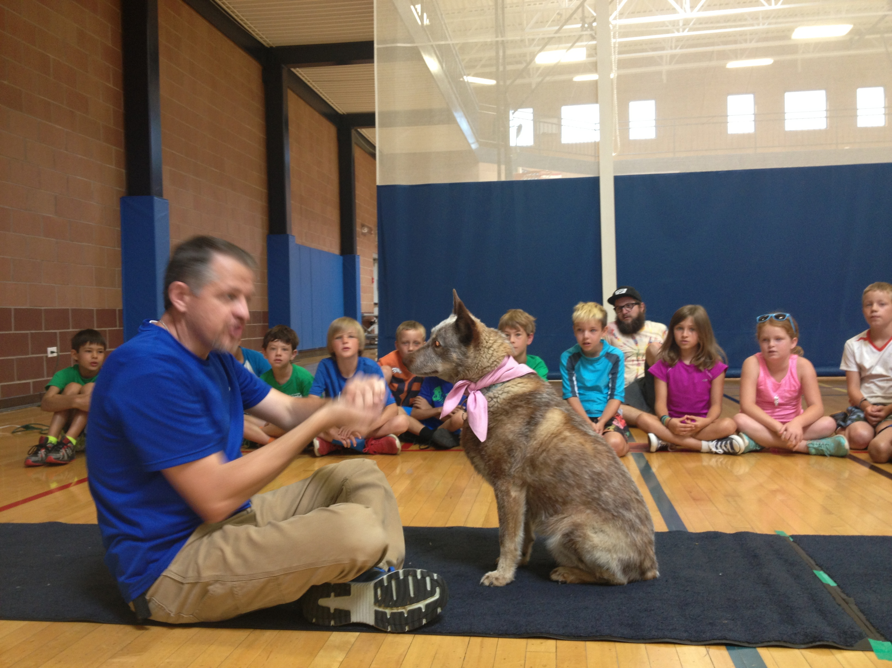
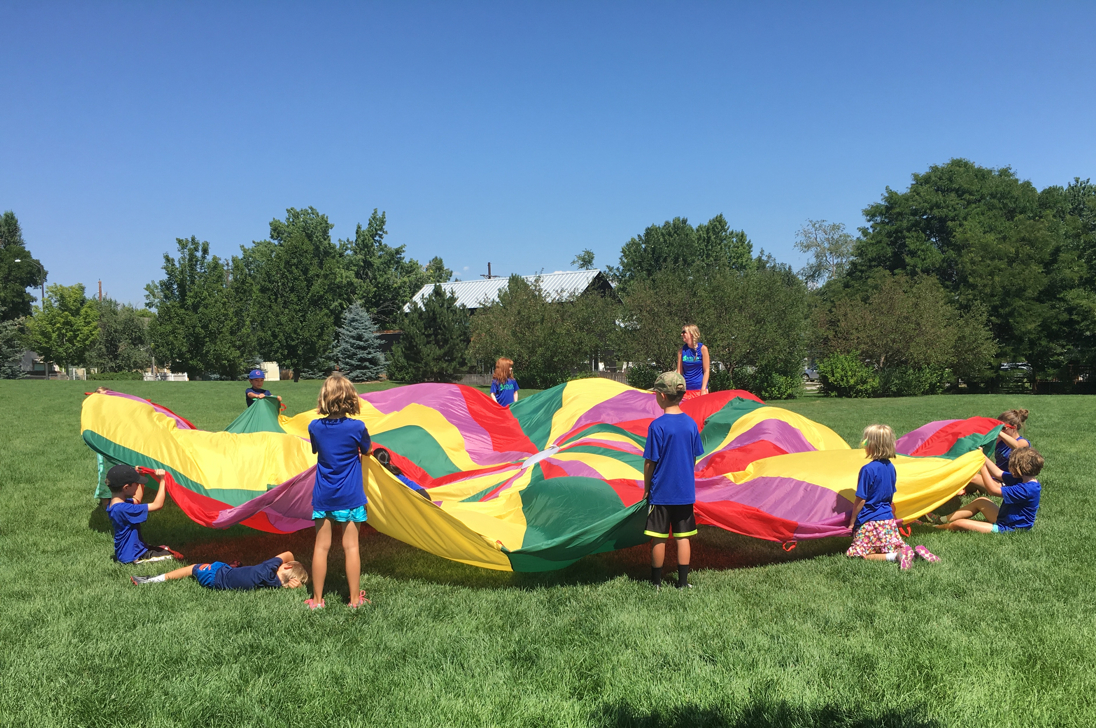
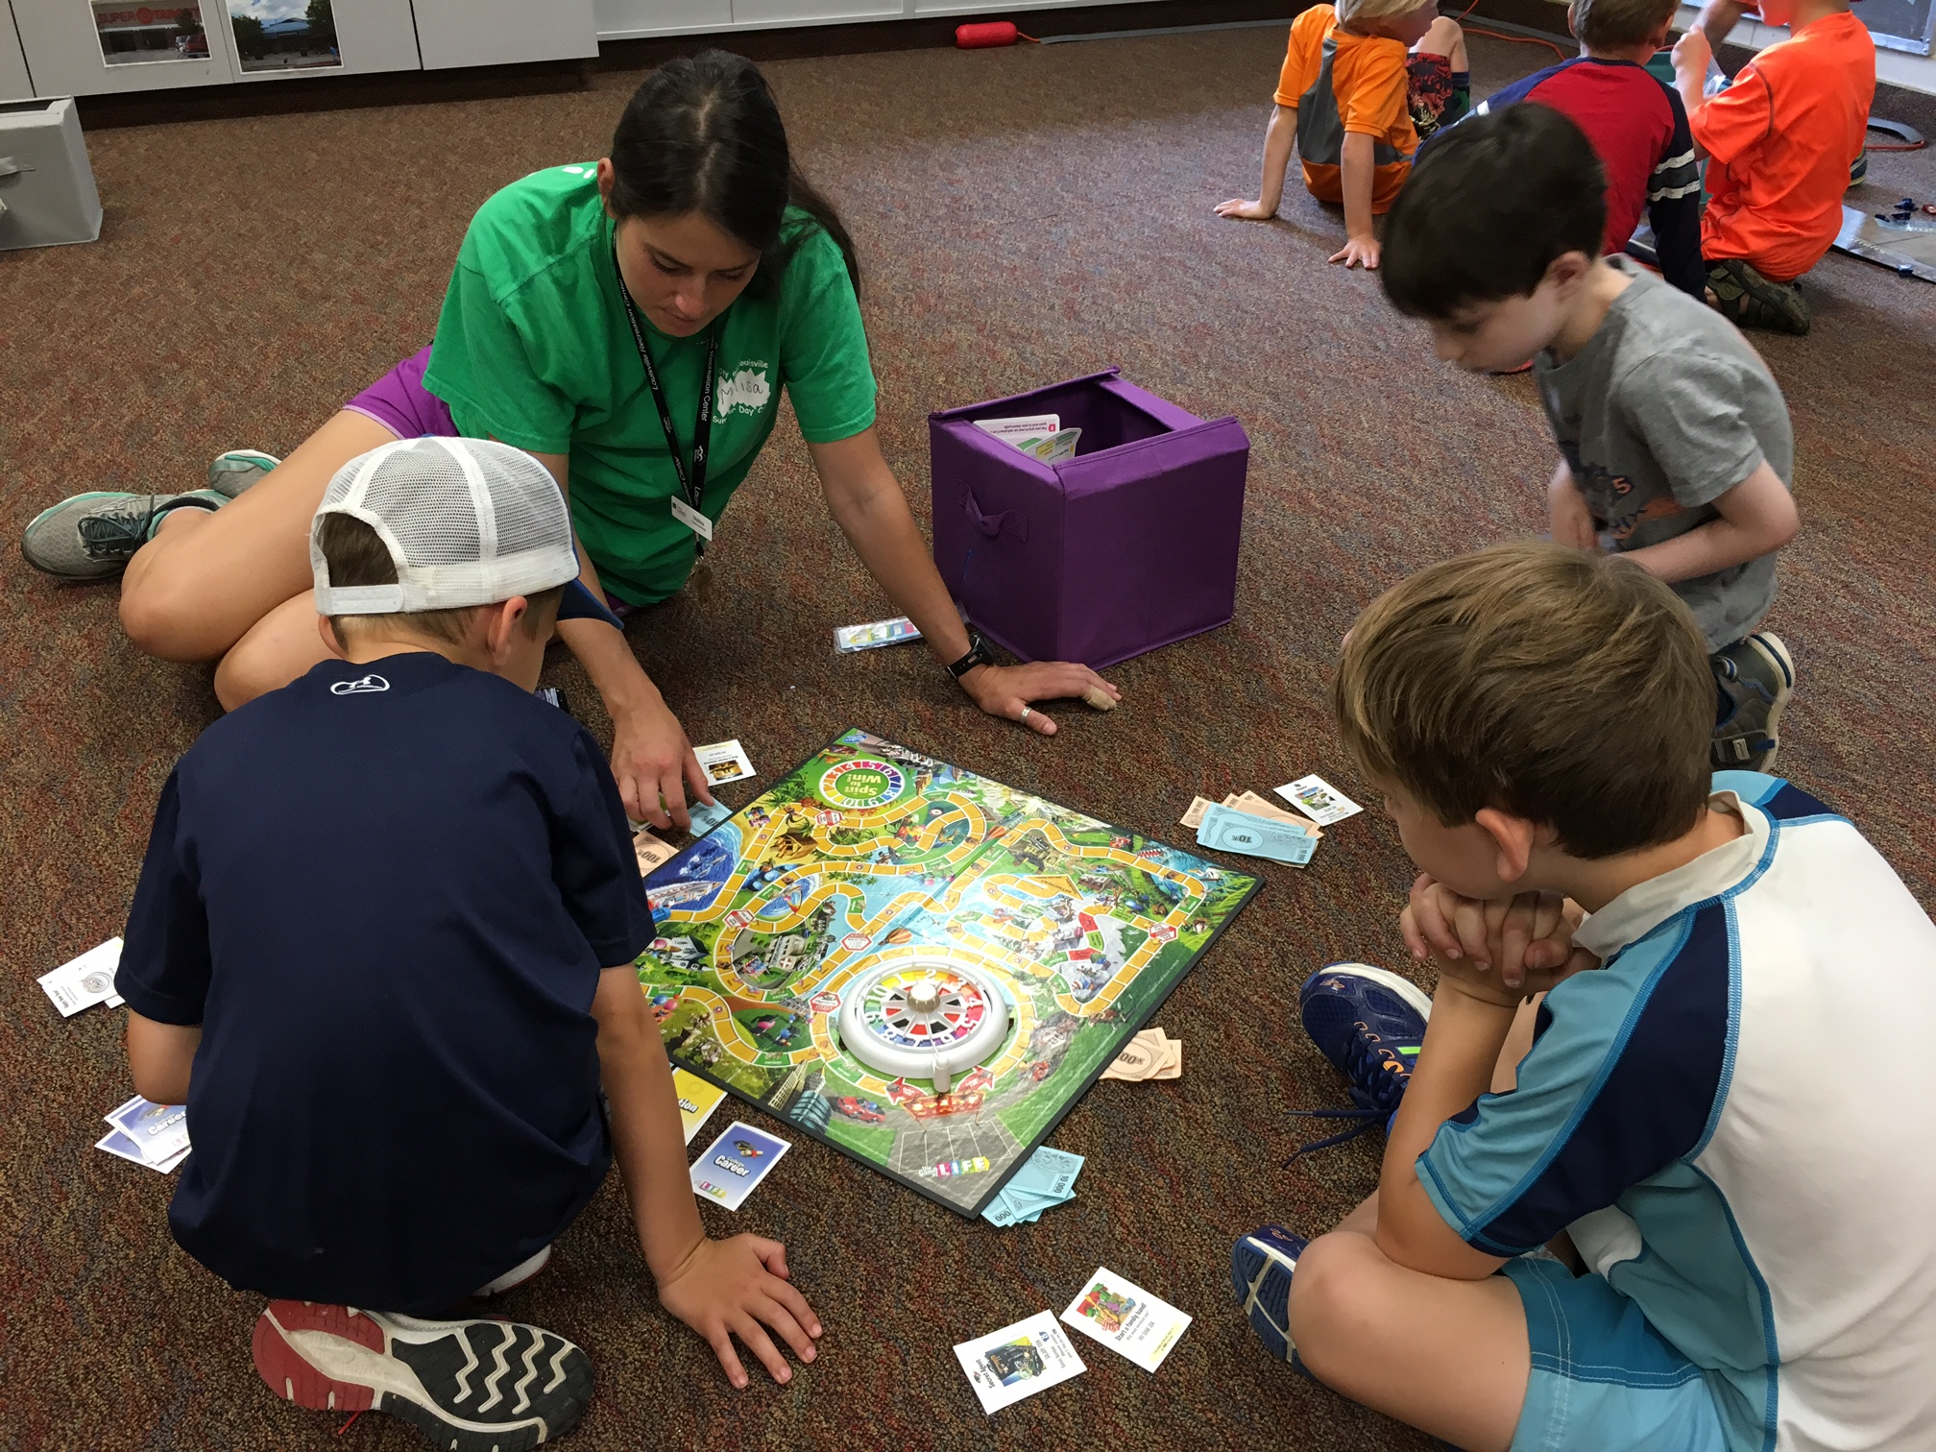
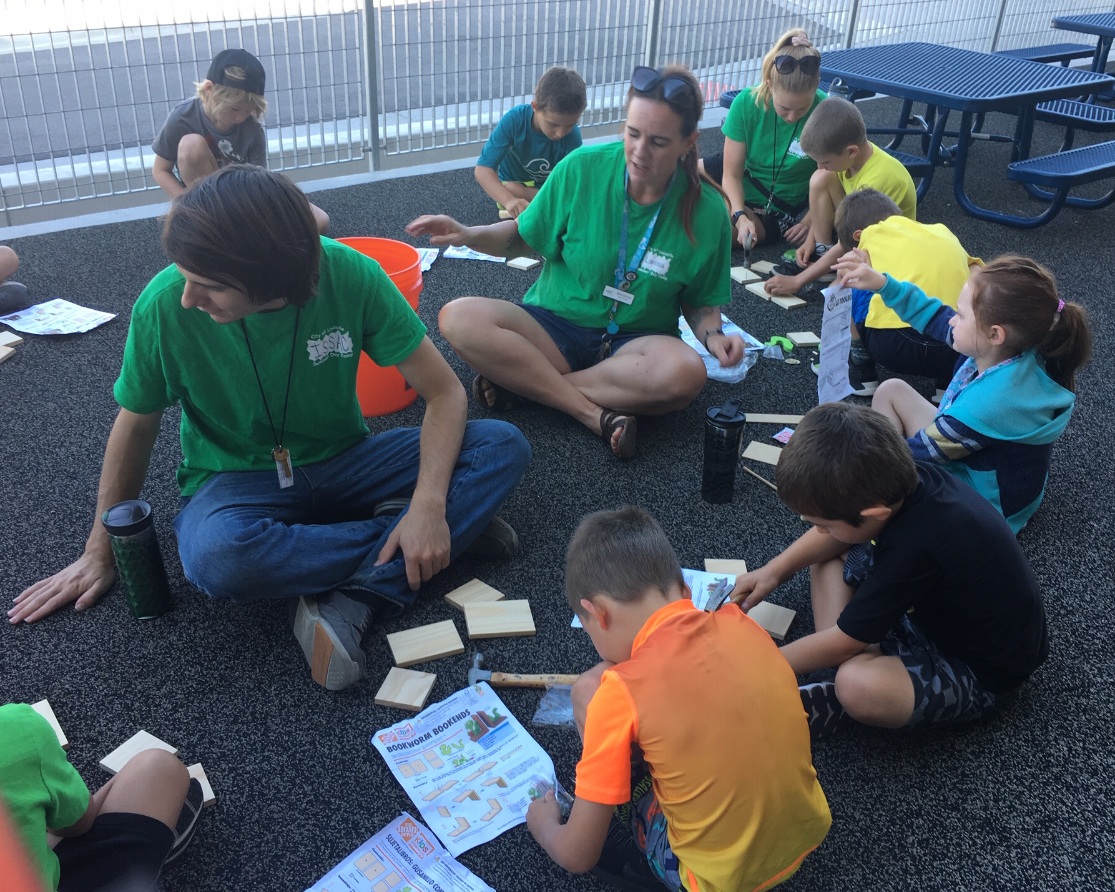
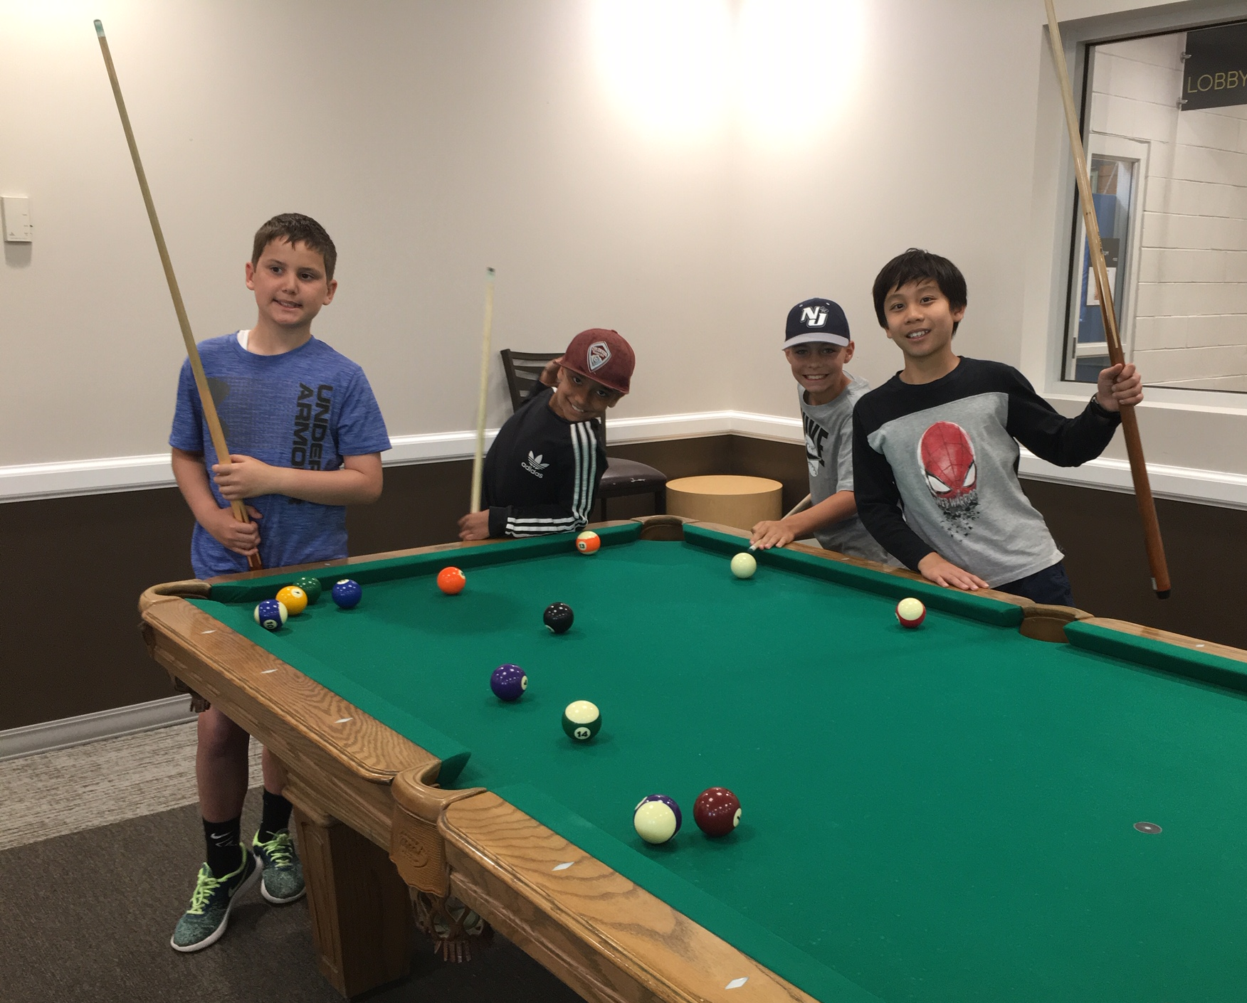
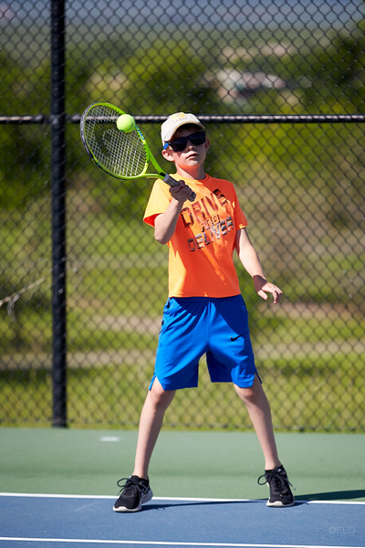
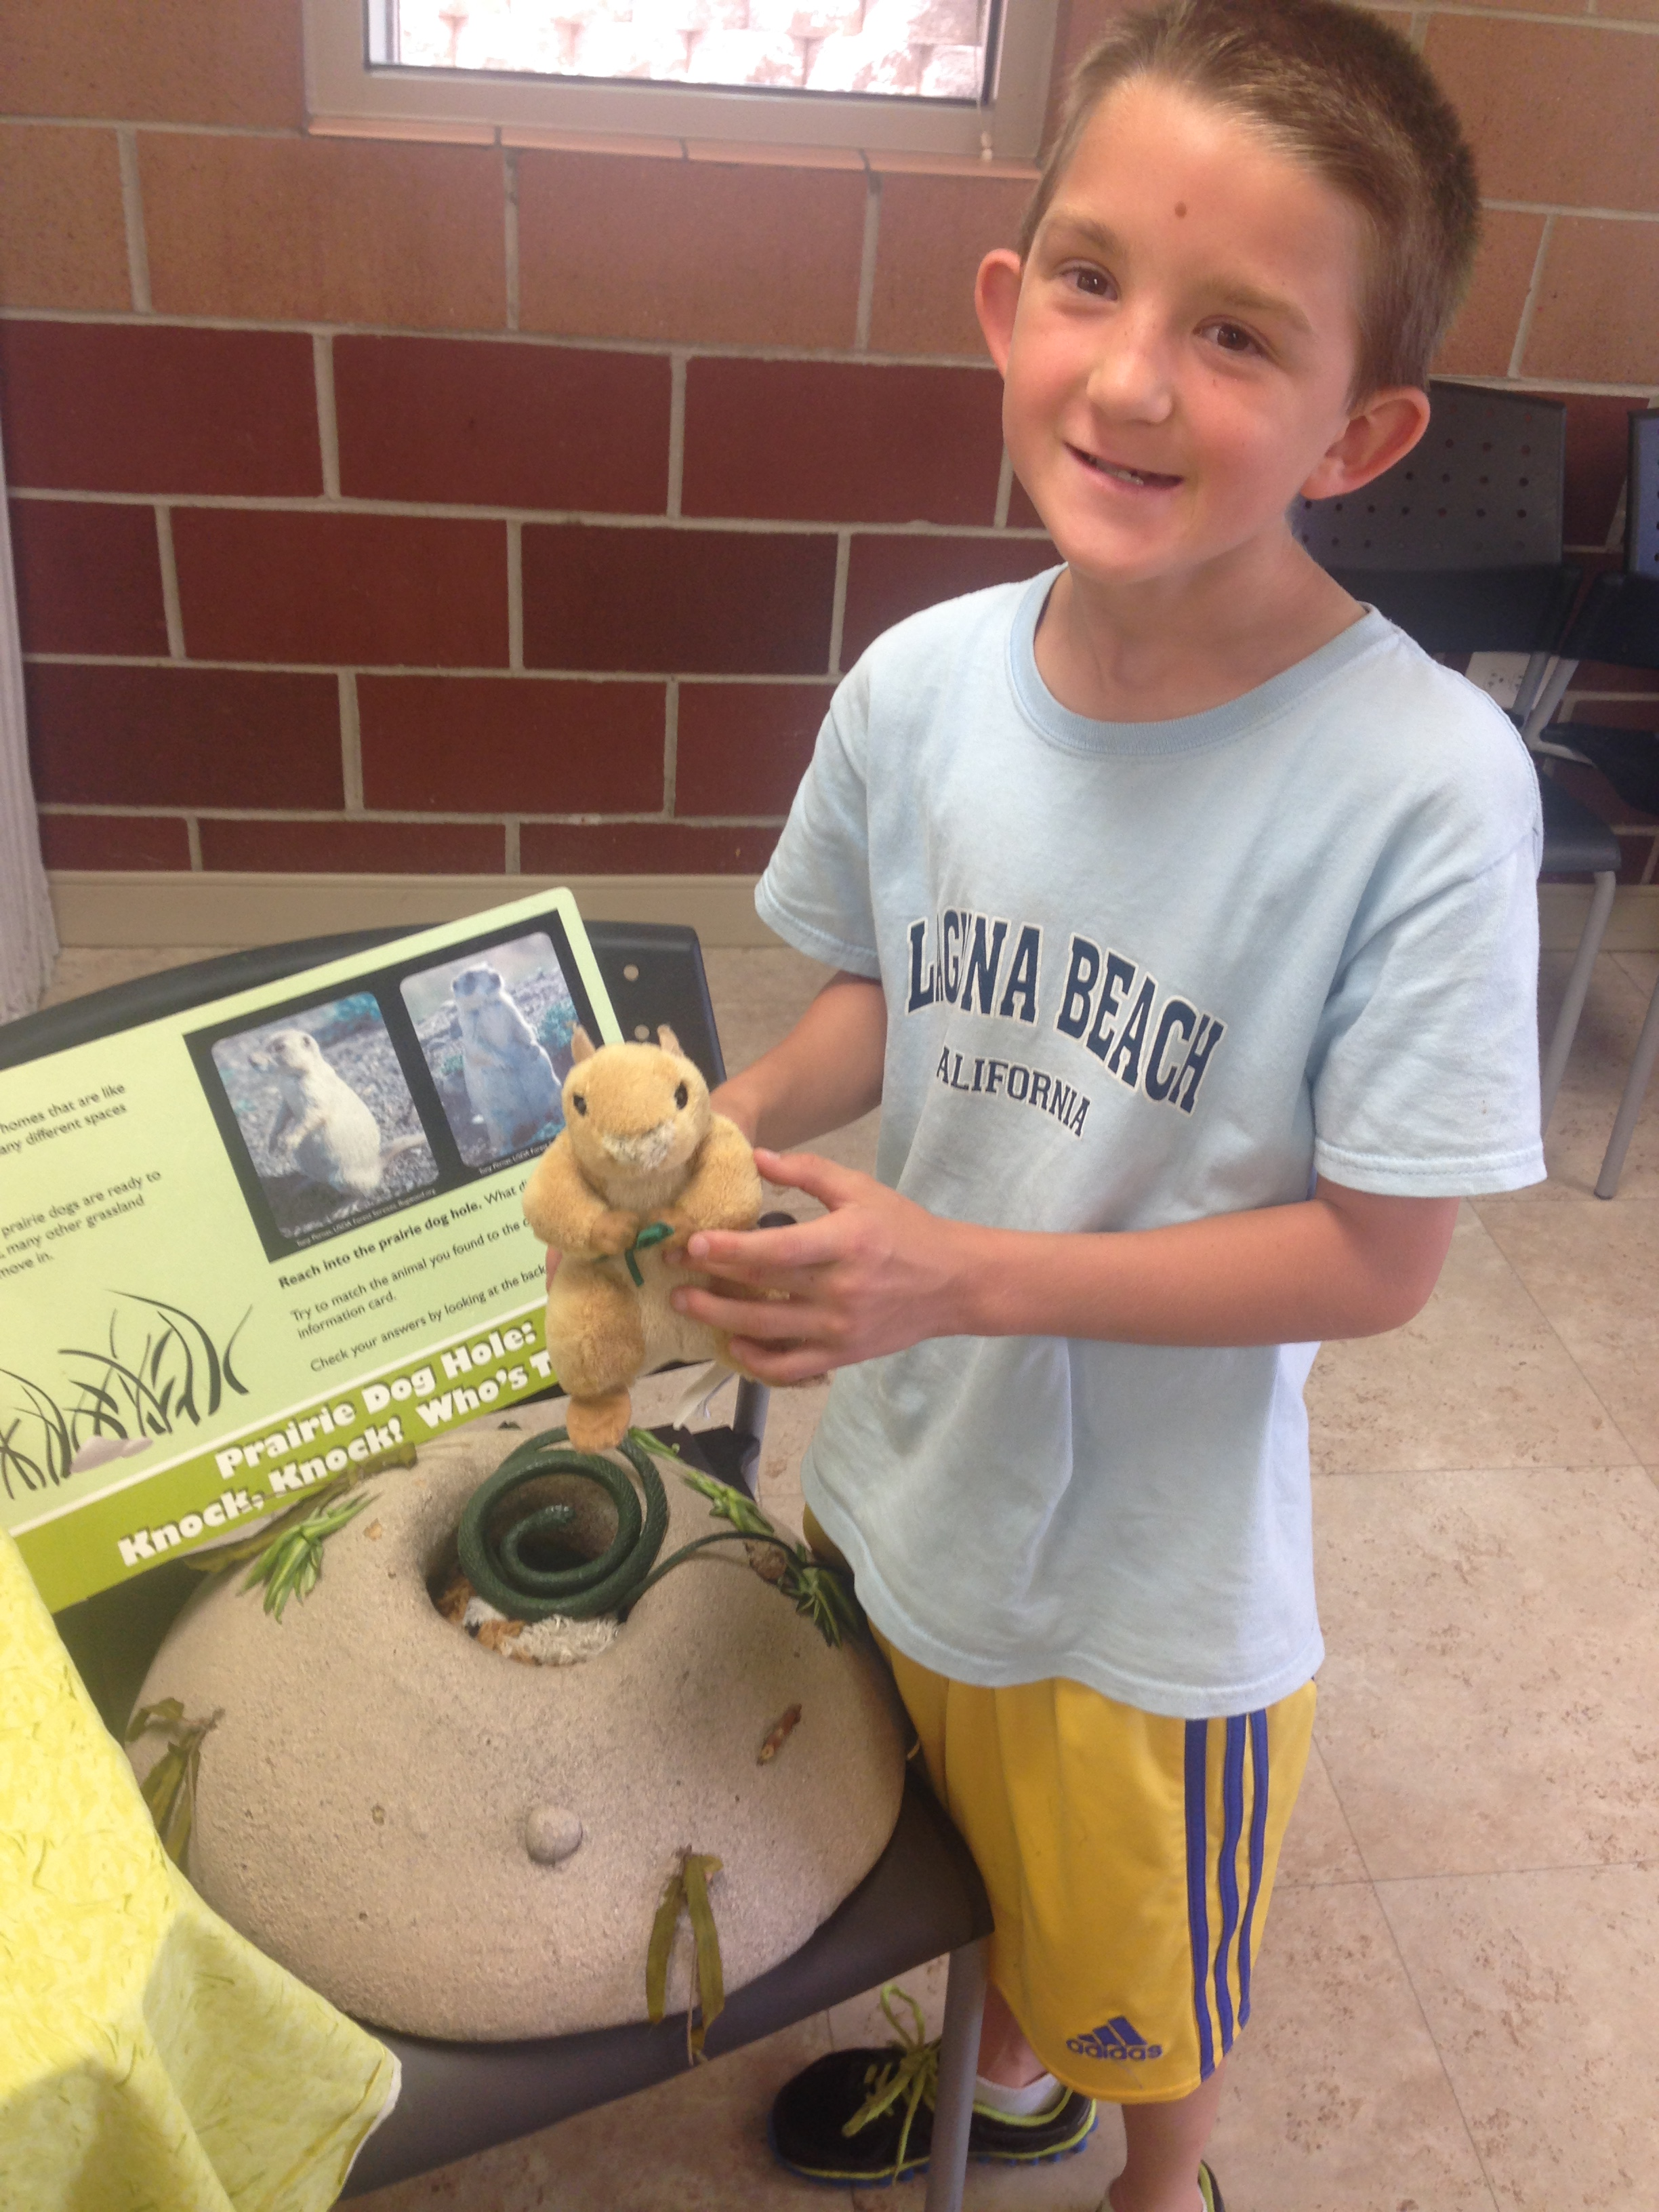
Special Activities & Guest Presentations
Notes:
Makenna

Slide 14


Guidance
Goal: safe & supportive environment while reinforcing social skills
Establish relationships, positive social interactions
We encourage campers to talk with counselors about anything that
concerns or worries them in camp
Seek and reward the positive
  Empathy, perseverance, fairness, leadership, integrity, generosity, courage
Natural and logical consequences
Model and teach problem solving skills and communication
Clearly stated expectations/directions
Redirection
Staff spread out to supervise multiple areas
Restorative justice
Talking with parents
  Above/Below and Bottom Line Behaviors
  Oops Slip
Is it safe and healthy?
Is it kind?
Notes:
Mandy – teachable moments, kids are learning, will talk with parents about Bottom line behaviors (hurting someone), but not necessarily below line (ex cutting in line)

Slide 15

Pre-existing Condition | Allergies | Medications
Allergy area/table for those who bring items with identified allergies- most often are nuts/nut butters.
Example: A camper has a trail mix with nuts for snack, that camper will sit in the allergy area and clean their hands before returning to play. A counselor is always in the allergy area/table.
Medications during camp hours
  Specific paperwork completed by heath care provider and parent/guardian uploaded in ePACT
  Medication in original, pharmacy labeled container
  Non-expired
Notes:
Mandy –any meds in camp, consult me

Slide 16
Safety is a priority
Training
Monitoring
Mandatory Reporters of suspected child abuse or neglect
Body Safety Rules
Physical contact should be limited to that necessary to teach a skill, treat or prevent an injury, or console or congratulate a child
Facility video surveillance
Zero tolerance for bullying
National Centre Against Bullying definition of bullying: when an individual or a group of people with more power, repeatedly and intentionally cause hurt or harm to another person or group of people who feel helpless to respond. Bullying can continue over time, is often hidden from adults, and will probably continue if no action is taken.
Notes:
Mandy –lots of front-loading, training, and planning

Slide 17

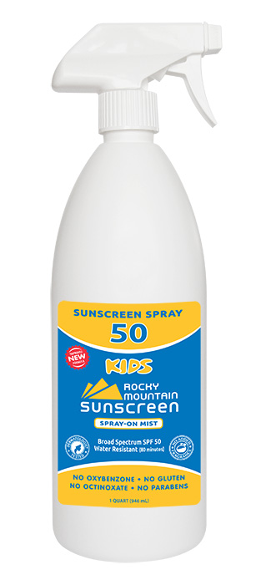
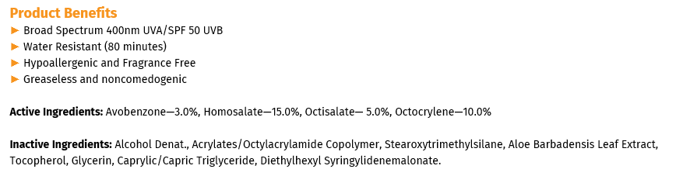

Sunscreen
We take protection from the sun seriously by adhering to a strict sunscreen application protocol, encouraging sun protection and providing swim shirts. Camp uses Rocky Mountain/Coral Isles Sunscreen
Required: Apply first coat of sunscreen before dropping off your camper
Recommended: Clothing that provides sun-protection (hats, covered shoulders)
Campers will reapply sunscreen throughout the day with Rocky Mountain Sunscreen
Personal sunscreen is permitted with approval from Assistant Director. Sunscreen must be provided in the original container with your camper’s first and last name and stored with camp counselors and not carried by campers.
Notes:
Mandy –Rocky Mt Sunscreen multiple times per day. Individual sunscreen only with a note from your health care provider

Slide 18


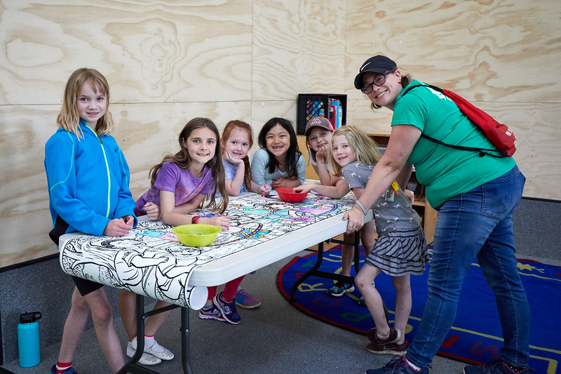
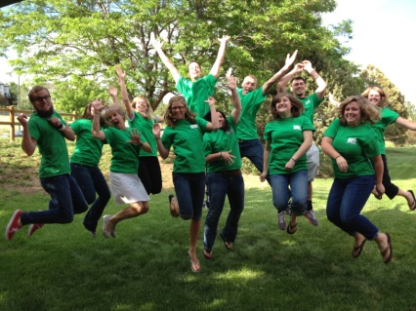
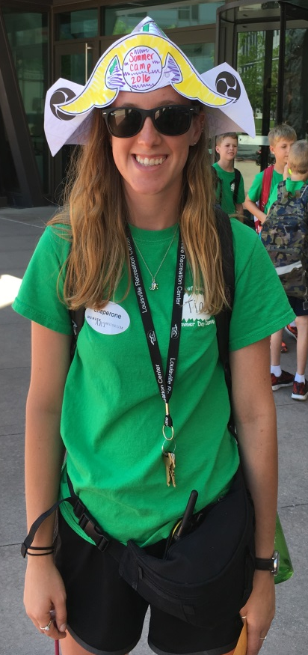
Camp Staff
We seek to hire staff with a variety of interests and backgrounds: most staff are high school & college students and occasional professional school district staff.
15+ Hours of Training
To protect children and staff, we ask that families do not arrange babysitting or childcare with our staff outside of our program.
At the helm, Mandy Perera, Recreation Supervisor
  20+ summer supervising Summer Day Camp, 30+ years in recreation
Notes:
Mandy – Great camp = great summer, 1/2 return, ½ new, 20+ hours of training.

Slide 19
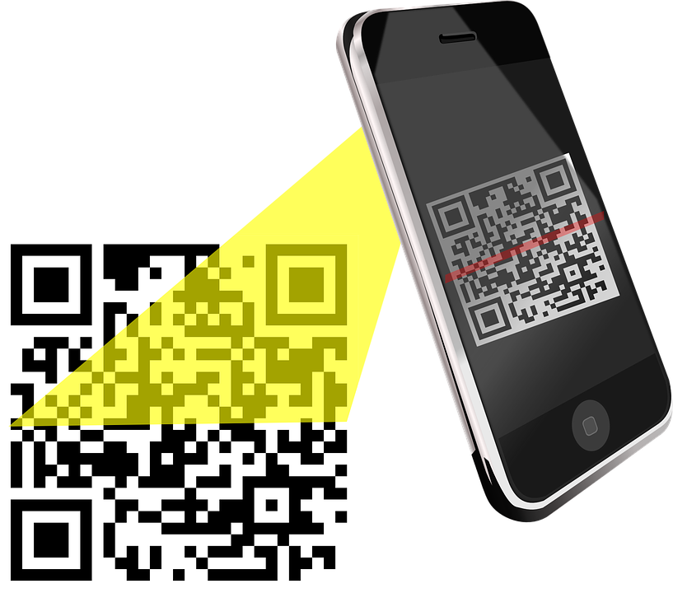

New Camper Information Database
ePACT
Digital paperwork process
Streamline and simplify the process
Make any needed updates online for real-time updates
QR Code for check in and check out
Pre-load daily sunscreen question
Easy to update each year
Used at many Colorado child care programs
DOWNLOAD YOUR WEB-BASED APP
Notes:
Mandy –contactless check in/out with QR code, real-time updates, Due by this Sunday, May 29

Slide 20
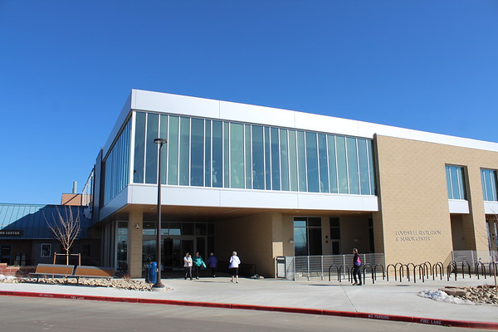
Contacts
Assistant Directors: To be hired
Camp Cell Phone: 720-614-9539
Recreation Supervisor: Mandy Perera
E-mail: mandyp@louisvilleco.gov
Office: 303-335-4902
Louisville Recreation & Senior Center
900 W Via Appia Way
www.louisvillerecreation.com
Front Desk: 303-666-7400
Notes:
Mandy- encourage you to speak with Regan and Makenna for any needs, my door is always open

Slide 21
Thank you for choosing Summer Day Camp, we look forward to seeing you soon!
Notes:
Mandy

